Slide 1
Detecting Local Clusters with Kulldorf’s Scan Statistic
Hugh Sturrock

Slide 2
Spatial Scan Statistics
Scan statistics – based on comparisons of local rate estimates
Does the ratio of cases to controls (or cases per population at risk) appear “significantly” elevated in certain areas
Goal is to detect specific clusters where the observed rate (or ratio) is inconsistent with the rate (or ratio) over the rest of the study area.

Slide 3
H₁ : There is an elevated risk within the window as compared to outside, for each location and size. H₀: The risk of an event is the same within and outside the window

Slide 4
Kulldorff’s Spatial Scan Statistic
Creates an infinite number of circular (or elliptical) windows of varying sizes around each point, maximum size = fixed proportion of pop.
Likelihood ratio test that the null model fits the data
Significance estimated using Monte Carlo methods – moving values around points randomly to estimate probability that observed pattern occurred by chance.
Can be extended to space-time using cylindrical window
Notes:
Sample of overlapping circles of different sizes created and used by SaTScan

Slide 5
Probabilistic Models
There are different types of probabilistic models for discrete scan statistics
Selection is based on the underlying distribution of the population at risk
Poisson: number of events in a geographical location is Poisson-distributed, according to a known underlying population at risk
Bernoulli: 0/1 event data such as cases and controls
Ordinal: Ordered categorical data such as severity of disease
Exponential: Survival time data
Normal: Other types of continuous data

Slide 6
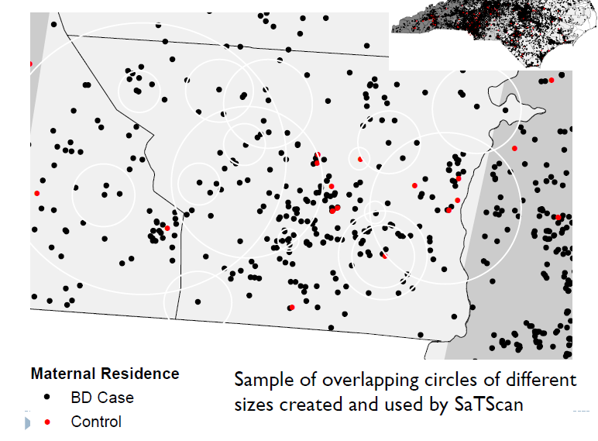
Bernoulli Model
Uses case control data
Uses Bernoulli model (identical to binomial with single trial) to compare risk of being a case inside to outside the window.
Control
Malaria case
Notes:
This test uses a circular window that moves systematically throughout the geographic space to identify significant clustering of cases. The window is centred on each of a number of possible locations throughout the study area and at each location, the window size varies from zero to a pre defined upper limit (often 50% of the study population, which allows both small and large clusters to be detected, while ignoring clusters that contain more than 50% of the population). For each location and size of the scanning window, a likelihood ratio test is conducted to test the hypothesis that there is an elevated rate of disease as compared with the distribution outside. The window size and location with the maximum likelihood is defined as the “most likely” cluster (i.e. least likely to have occurred by chance). The distribution and p-value of the most likely and secondary clusters are determined by conducting Monte Carlo replications of the data set.

Slide 7
Bernoulli Results
Uses case control data
Uses Bernoulli model (identical to binomial with single trial) to compare risk of being a case inside to outside the window.
6/36 = 0.16
11/232 = 0.05
Control
Malaria case
Notes:
This test uses a circular window that moves systematically throughout the geographic space to identify significant clustering of cases. The window is centred on each of a number of possible locations throughout the study area and at each location, the window size varies from zero to a pre defined upper limit (often 50% of the study population, which allows both small and large clusters to be detected, while ignoring clusters that contain more than 50% of the population). For each location and size of the scanning window, a likelihood ratio test is conducted to test the hypothesis that there is an elevated rate of disease as compared with the distribution outside. The window size and location with the maximum likelihood is defined as the “most likely” cluster (i.e. least likely to have occurred by chance). The distribution and p-value of the most likely and secondary clusters are determined by conducting Monte Carlo replications of the data set.

Slide 8
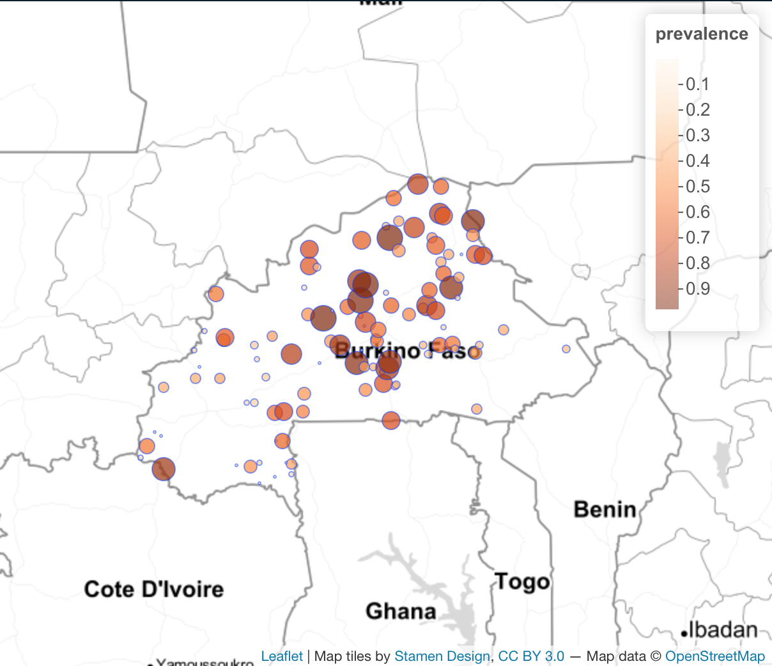
Binomial Model
Uses point prevalence data
Similar to the case-control scenario, but uses binomial model instead of Bernoulli, as our data are numbers positive and numbers examined (i.e. Binomial).

Slide 9
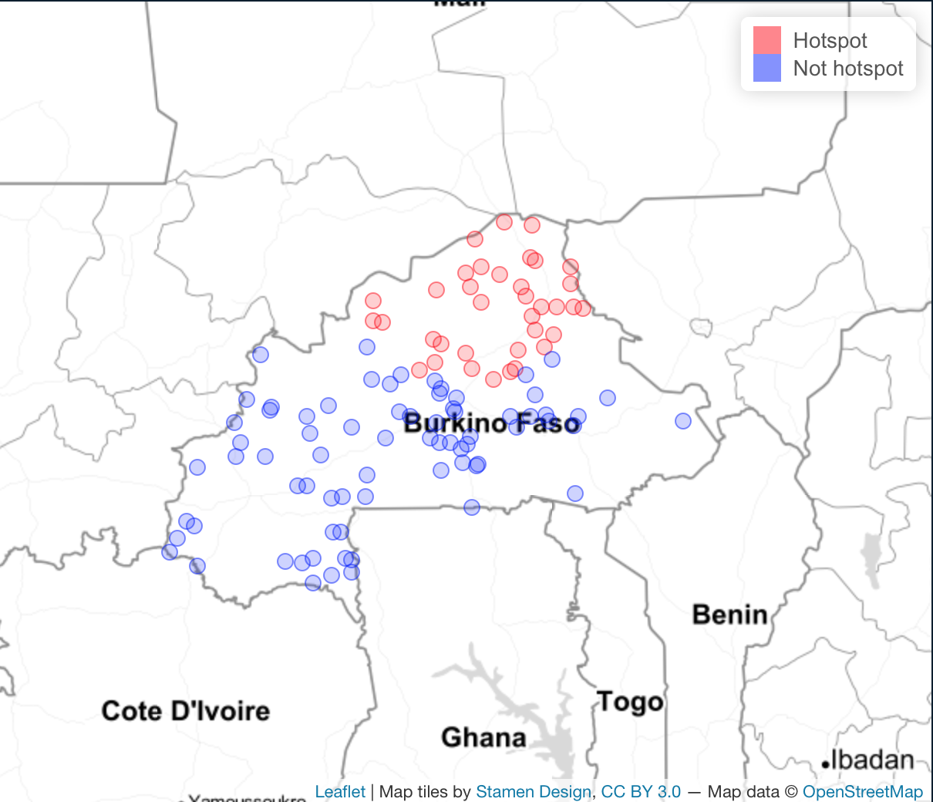
Binomial Results
Uses point prevalence data
Similar to the case-control scenario, but uses binomial model instead of Bernoulli, as our data are numbers positive and numbers examined (i.e. Binomial).

Slide 10
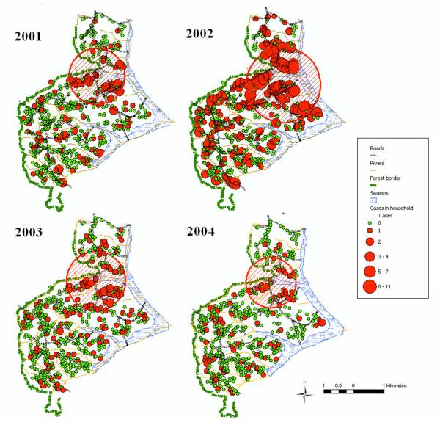
Poisson Model
Ernst, Kacey C., et al. "Malaria hotspot areas in a highland Kenya site are consistent in epidemic and non-epidemic years and are associated with ecological factors." Malaria journal 5.1 (2006): 78.

Slide 11
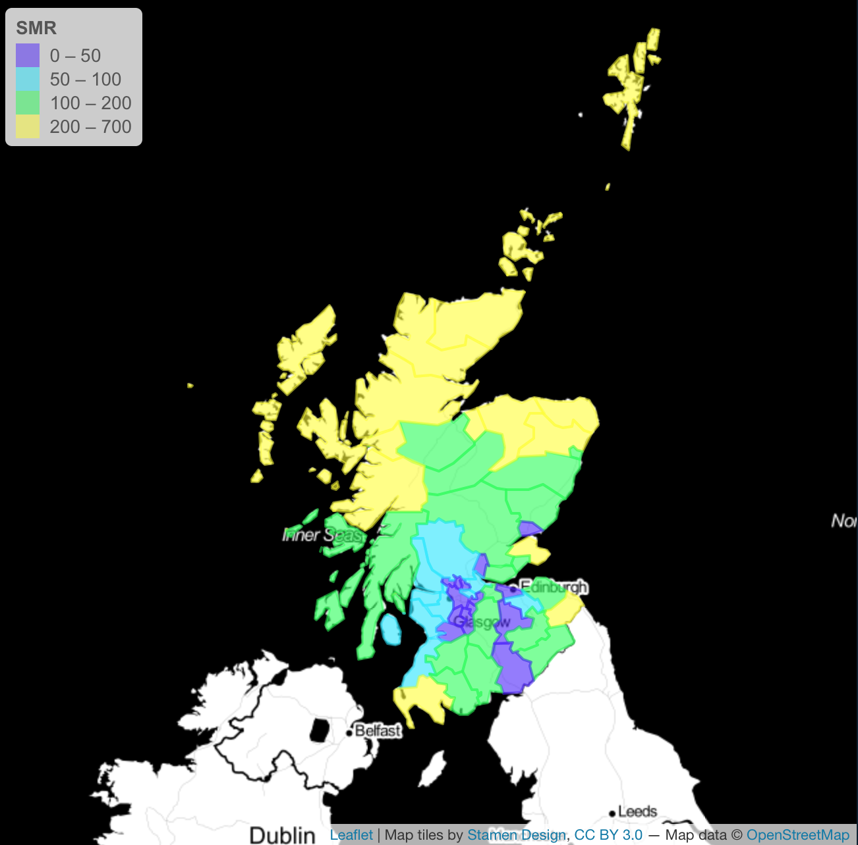
Poisson Model
Uses areal level data
County-level (n=56) data for lip cancer among males in Scotland between 1975-1980
The number of events in an area is Poisson distributed under the null hypothesis.
Number of cases is compared to the background population data and the expected number of cases is proportional to the size of the population at risk in each circle.

Slide 12
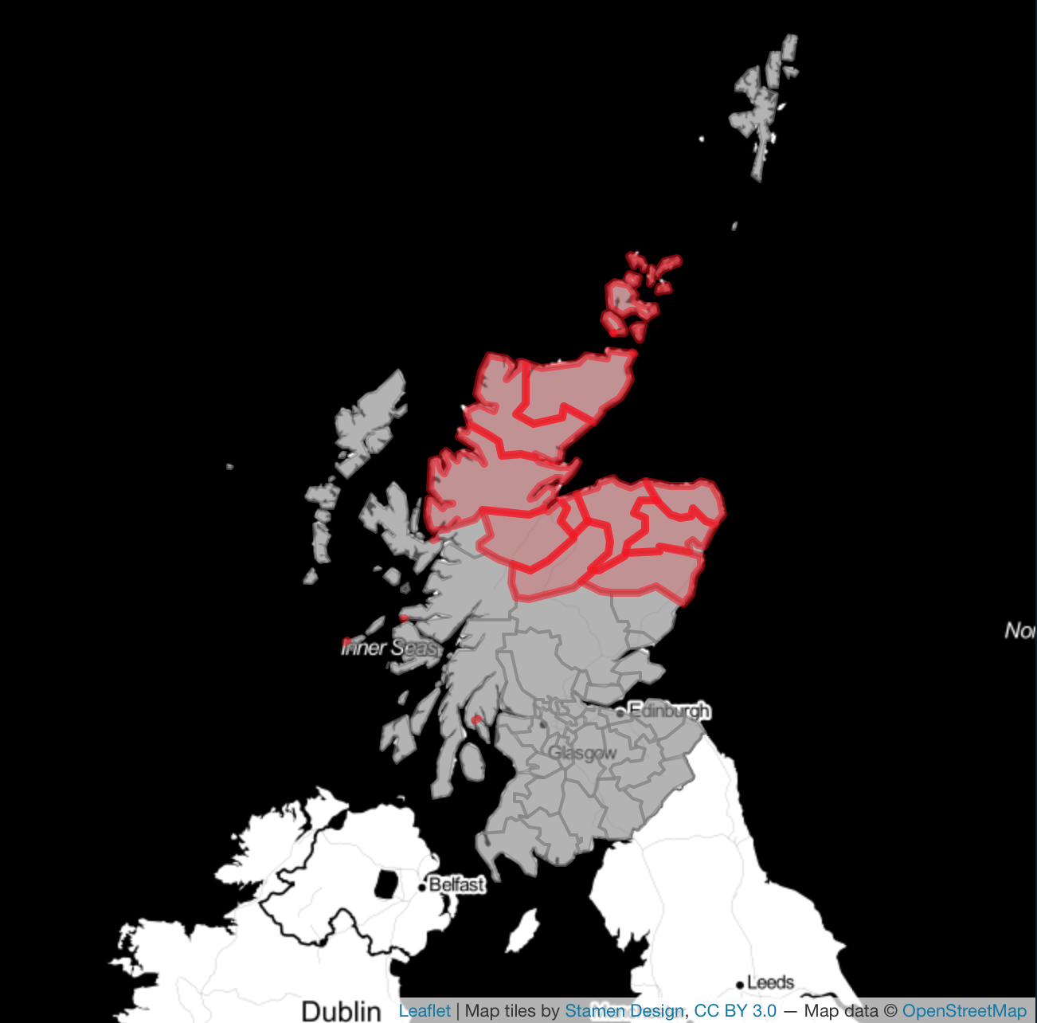
Poisson Results
Uses areal level data
County-level (n=56) data for lip cancer among males in Scotland between 1975-1980
The number of events in an area is Poisson distributed under the null hypothesis.
Number of cases is compared to the background population data and the expected number of cases is proportional to the size of the population at risk in each circle.

Slide 13
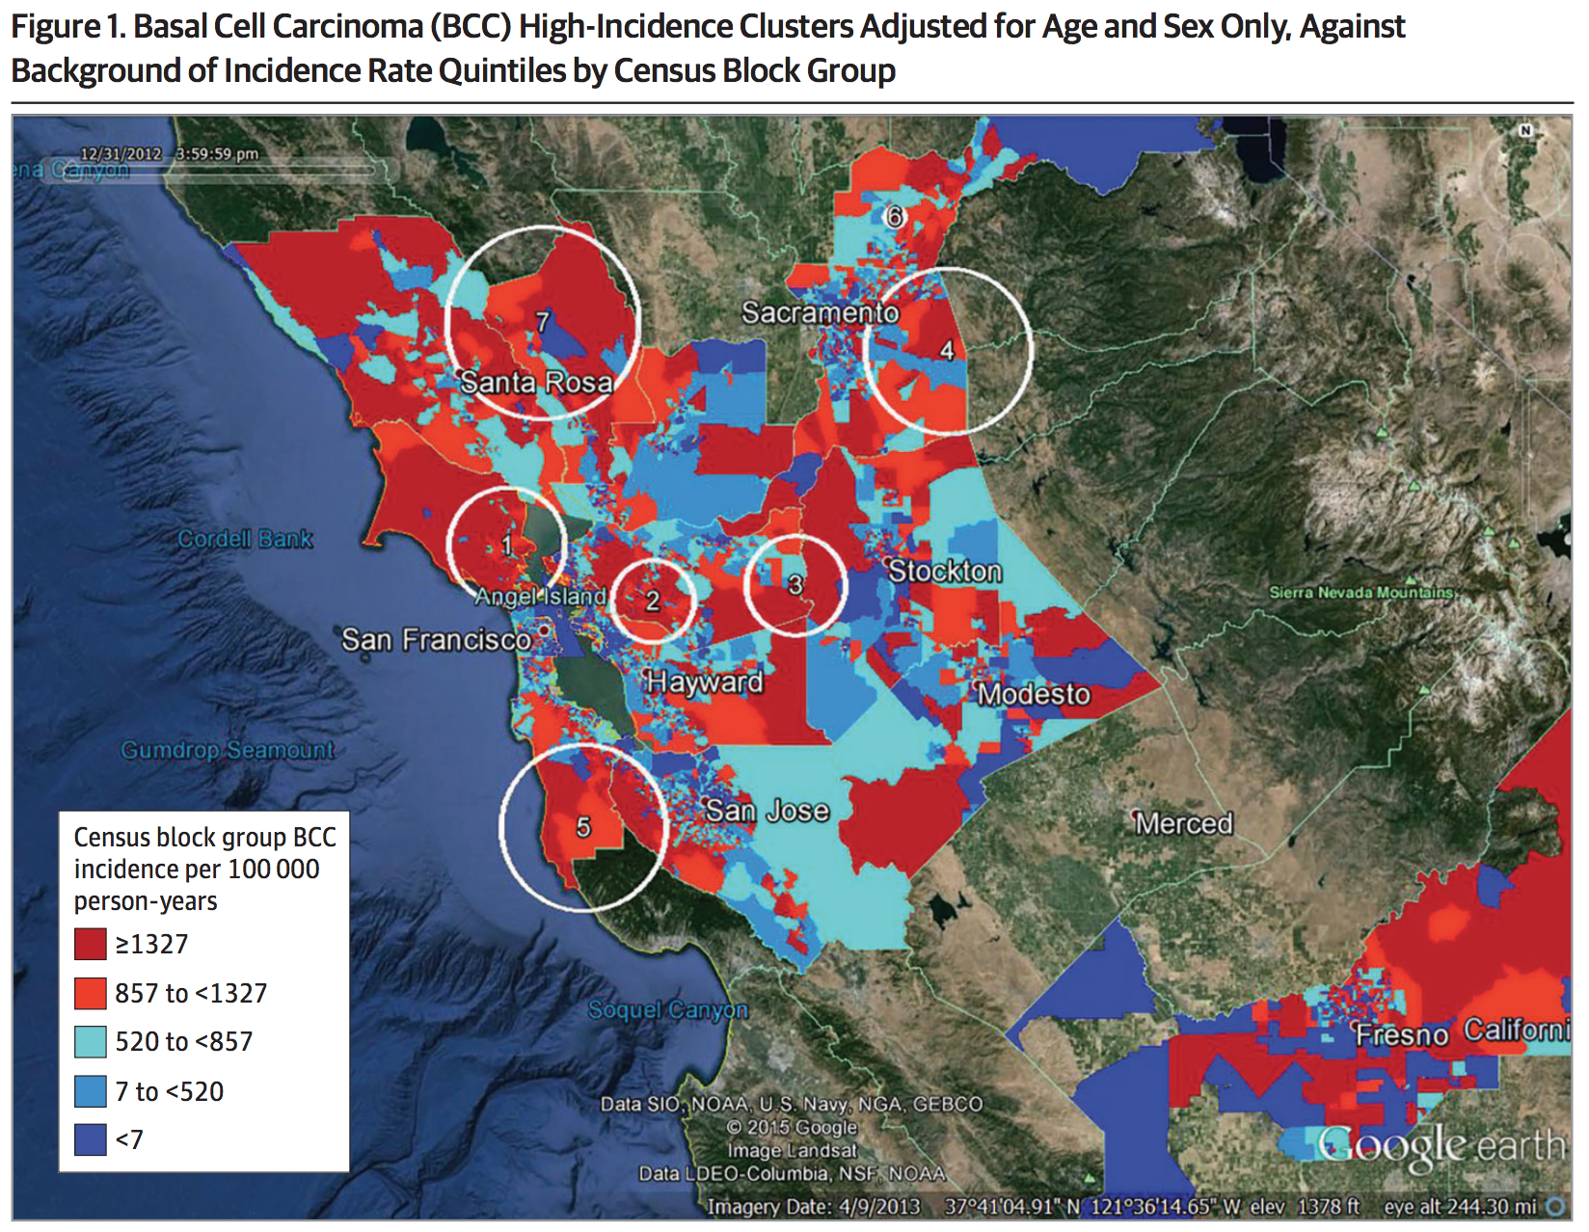
Poisson Model
Thomas et al, "Geographic clusters of basal cell carcinoma in a northern California health plan population." JAMA dermatology 152.11 (2016): 1218-1224.

